Slide 1
Long-tail Hashtag Recommendation for Micro-videos with Graph Convolutional Network
Year : 2019
Conference : CIKM
Author : Li Mengmeng

Slide 2
Innovations
This paper recommends hashtags for micro-videos by presenting a novel multi-view representation interactive embedding model with jointly considering the sequential feature learning, the video-user-hashtag interaction, and the hashtag correlations.
As a side research contribution, dataset and codes are released to facilitate the research in this community.

Slide 3
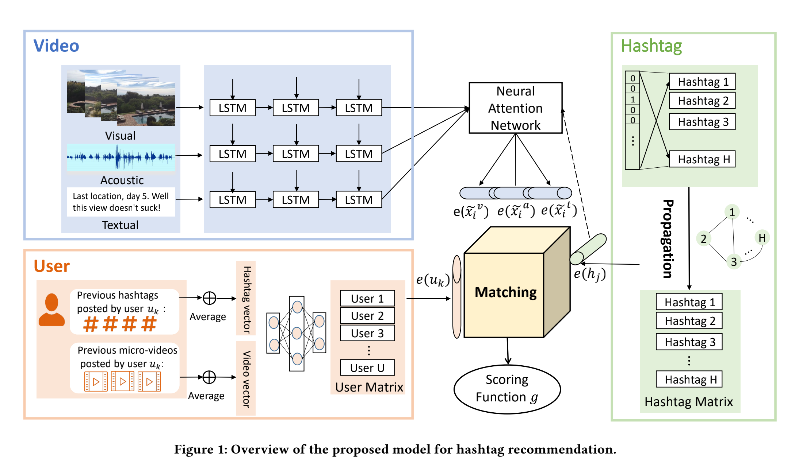

Slide 4





videos
hashtags
users
If a user assigns a hashtag on the video.
Goal : Predict a score for the triplet.

Slide 5
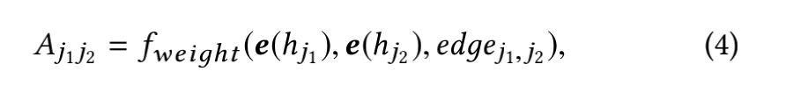
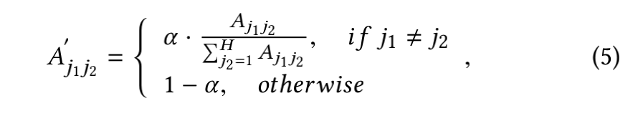
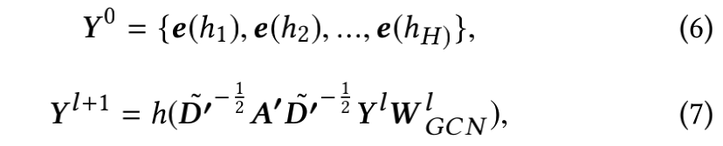
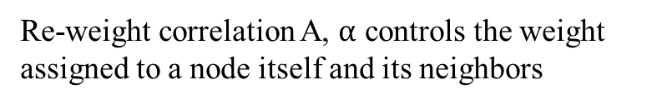
1、Hashtag Embedding
Four types of edges
Correlation matrix A computed by neural networks
Re-weight correlation A, $α$ controls the weight assigned to a node itself and its neighbors
GCN propagation formula

Slide 6

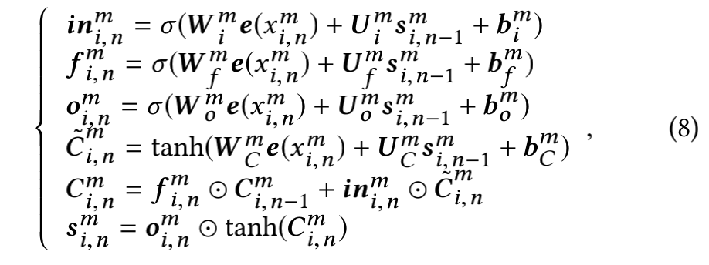
2、Micro-video Embedding
$e(x_{i,n}^{m})$ Denotes the feature for the $n$-th unit of the $i$-th micro-video, and $m∈\left\{v,a,t\right\}$denotes the visual modality v, acoustic modality a, or textual modality t.
Select 40 frames for each micro-video with uniform sampling. For each frame, extract a 2,048 dimensional feature vector with a pretrained ResNet on ImageNet.
Extract a 128-dimensional feature vector for each 0.2s audio clip. Uniformly sample 60 acoustic feature vectors for each micro-video.
Employ Word2Vec to generate vector representation for words, at most 6 words for each micro-video.

Slide 7
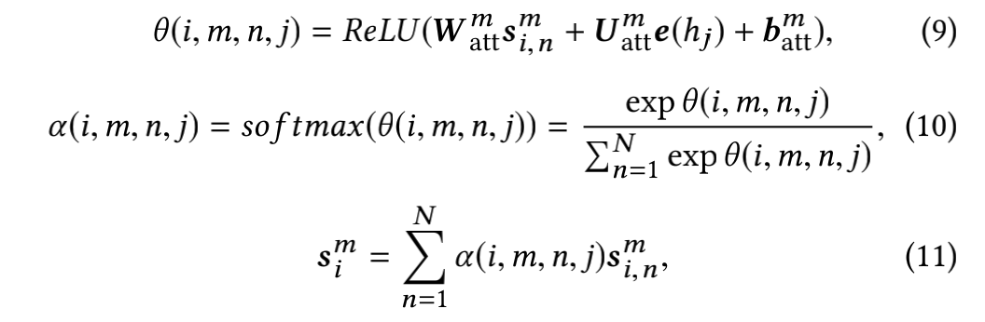
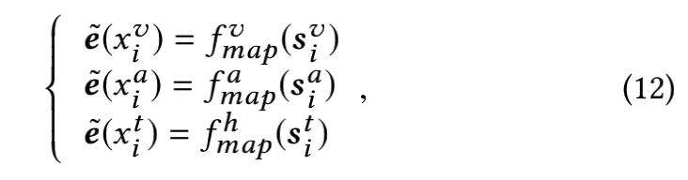
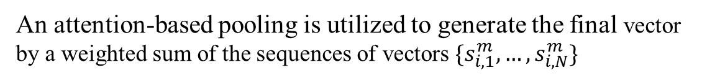
An attention-based pooling is utilized to generate the final vector by a weighted sum of the sequences of vectors $\{s_{i,1}^{m},…,s_{i,N}^{m}\}$

Slide 8
3、User Embedding
Visual features of micro-videos extracted with pretrained CNN
Textual feature of hashtags extracted with pretrained Word2Vec
These features are concatenated after an average pooling and fed into a three-layer fully connected neural network, resulting a user representation
self.user_embedding=nn.Embedding(user_num,embed_size)

Slide 9
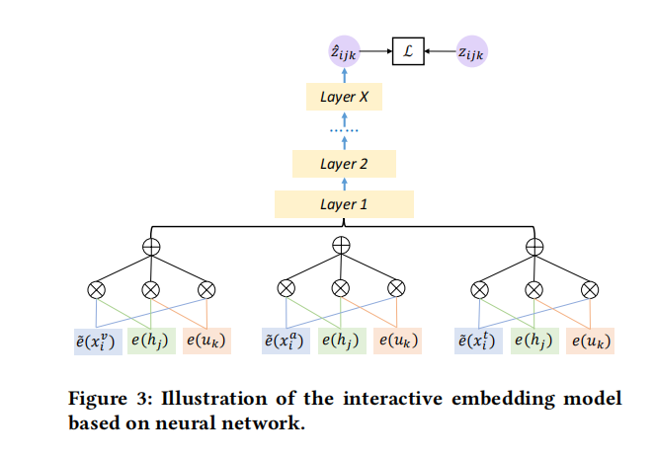
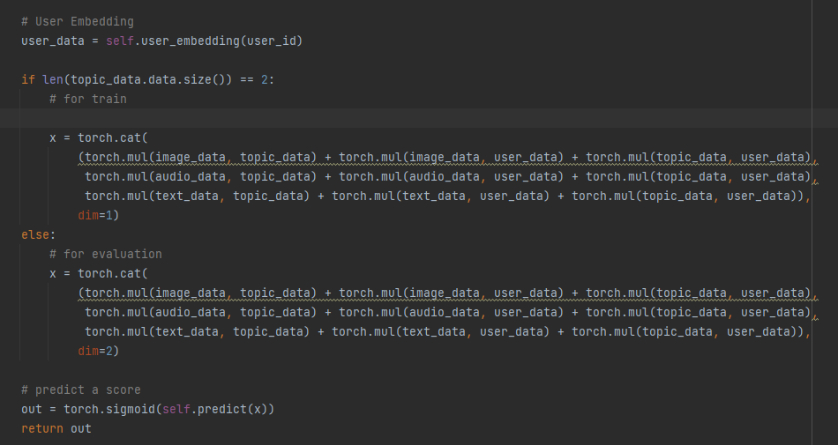
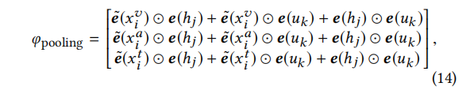
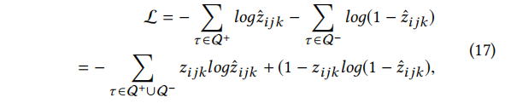

Slide 10
